Slide 1
HTMA – Part 1

Slide 2
There are a few resources to use to learn about HTMA and I encourage you to find each one.
What I am teaching is merely the basics of minerals and patterns, but also, and most important, applying this knowledge through the functional wellness concepts that are taught here in the Mentorship.

Slide 3
What happens when you add in a mineral in isolation?

Slide 4
Can you balance minerals by adding in other minerals?

Slide 5
What are some things that cause minerals to be imbalanced?

Slide 6
Why do we test hair?

Slide 7
All forms of testing – blood, urine, stool - can provide insight for various reasons. Hair is not the only test we use but it must be considered by its strengths and weaknesses.

Slide 8
Blood, urine, stool and hair all tell us different things but because of their constituencies, cannot be compared apples to apples.
Just like we look for clues in blood work, HTMA can give suggestions of trends early on.

Slide 9
Blood is the highway, moving things along. We can see what is on the highway but nothing beyond the off ramps (tissues).
Stool is the culmination of what comes through the gut and gives clues to digestion and imbalances that exist right in that space.
Urine shows what the body is excreting, such as metabolites on an OAT or iodine sufficiency based on excretion.
None of these can give accurate info on the movement of minerals in the cells and tissues.

Slide 10
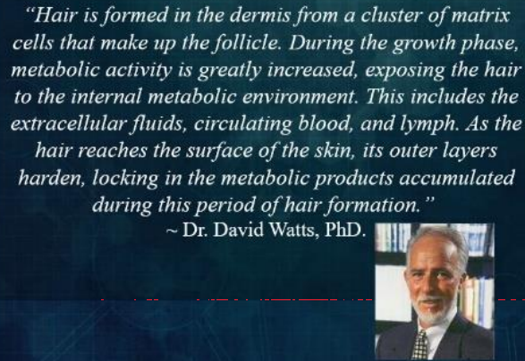
Rick Fischer, “Mineral Mastery”

Slide 11
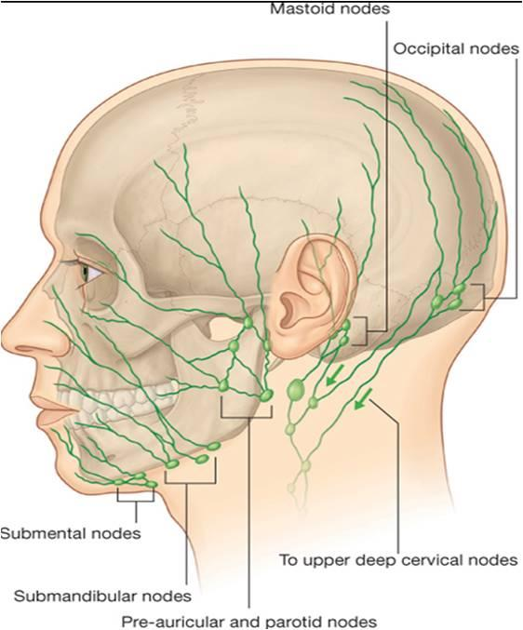

Slide 12
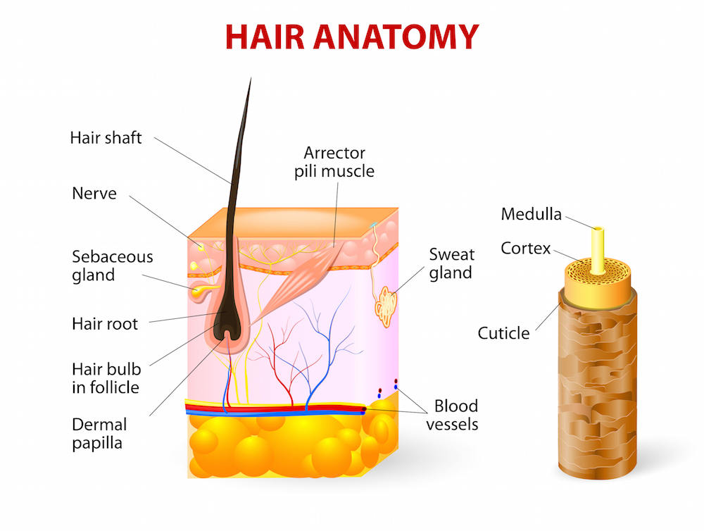

Slide 13
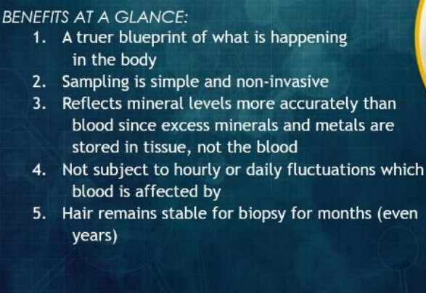
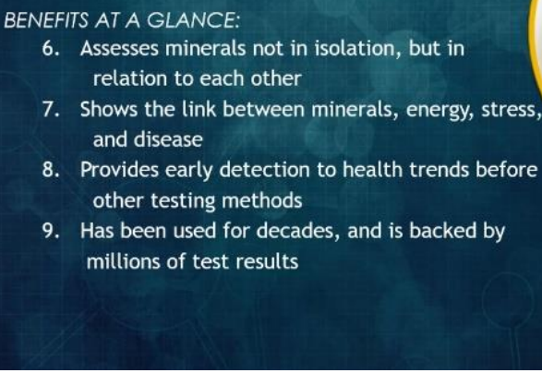
Rick Fischer, “Mineral Mastery”

Slide 14
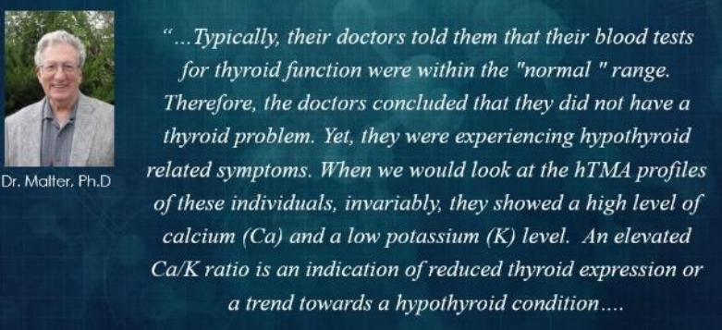
Comparing blood and hair with this knowledge…
Rick Fischer, “Mineral Mastery”

Slide 15
Minerals
Minerals are some of the most impactful factors involved with our health.
Consider what changes in health are possible when using just a bit of salt and potassium.
Notice how stress can be reduced with just a small amount of magnesium.

Slide 16
Each mineral in our body has a love hate relationship with each other.
Some work to support each other and still others will oppose the other.

Slide 17
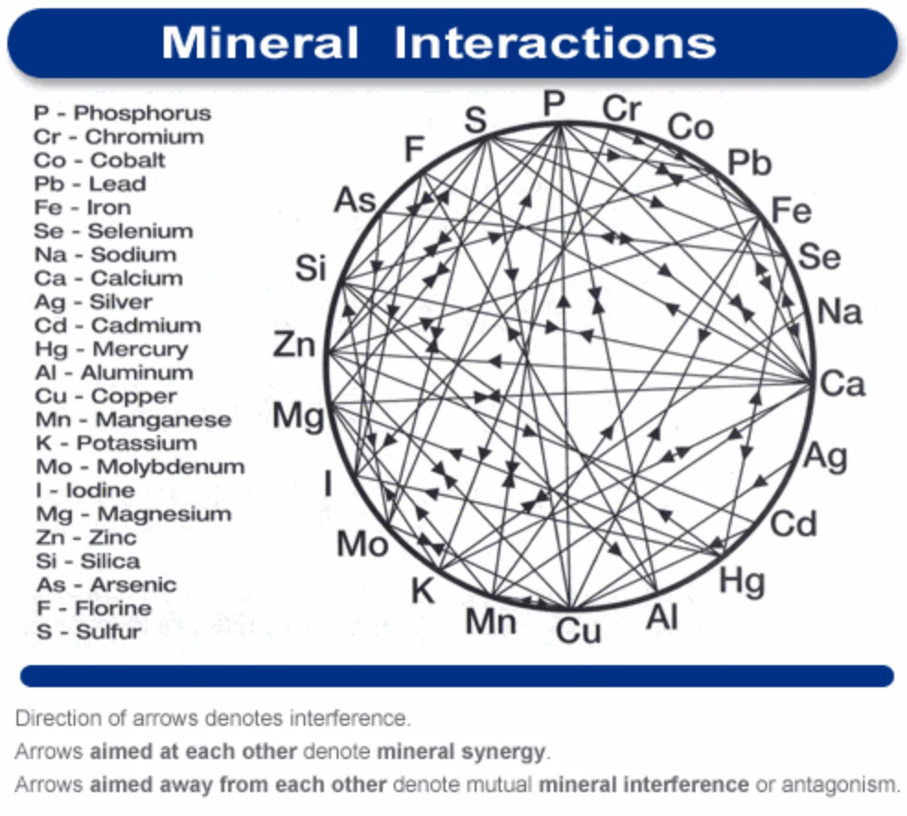

Slide 18
Vitamin C (Ascorbic Acid)
Synergistic Nutrients
Copper
Post-absorptive, vitamin C can stimulate uptake and metabolism of copper. Vitamin C deficiency could lead to symptoms of copper deficiency.
Iron
Increases absorption of non-heme iron, even in the presence of inhibitory substances; vitamin C also regulates uptake and metabolism of iron.
Selenium
A diet high in vitamin C led to increased percent of absorption of sodium selenite and retention of the absorbed selenium.

Slide 19
Vitamin C (Ascorbic Acid)
Antagonistic Nutrients
Copper
High levels of vitamin C inhibits absorption of copper, possibly through increasing iron absorption, which is a copper antagonist.
Iron
Excess vitamin C could increase iron overload risk.
Selenium
Converts sodium selenite to elemental selenium which inhibits absorption but only when supplements are taken on an empty stomach.

Slide 20
Iron
High levels of calcium decrease absorption of non-heme iron in the short term but might not have a long-term impact on iron levels; this can be mitigated by vitamin C.
Supplementing with calcium and iron greatly reduced serum levels of zinc.
Magnesium
High levels of calcium decreased tissue levels of magnesium and exacerbates deficiency and decreases magnesium absorption.
Magnesium supplementation can decrease calcium absorption, especially in those with renal stone disease.

Slide 21
THE POWER OF ONE.
THE DETRIMENTAL EFFECTS OF TAKING JUST ONE MINERAL RANDOMLY.
Below is a simple illustration demonstrating the knock on effect that just one mineral has on 8 other minerals, just by taking an iron supplement.
1️⃣ Sodium goes up. This is the first thing that happens. The iron will cause sodium levels to rise as a consequence of stimulating the adrenal glands.
2️⃣ Magnesium goes down. Magnesium levels will go down because sodium lowers magnesium.
3️⃣ Calcium goes down. When magnesium goes down, calcium also goes down to try to maintain the same calcium/magnesium ratio.
4️⃣ Potassium goes up. Calcium and potassium also move in opposite directions. So when calcium goes down, potassium moves up.
5️⃣ Nitrogen goes down. Since the person is going into fast oxidation, he is starting to cannibalize his own proteins, instead of building them. This lowers the nitrogen level.

Slide 22
6️⃣ Copper goes down. Since tissue respiration is speeding up, copper is being used more quickly. If the copper is already at low levels, or, if the person has a high zinc to copper ratio, then his copper availability could plunge to dangerously low levels.
At levels below 1.0, the person moves into a cancer danger zone as bioavailable Cu is the number one protector of cancer in the body.
7️⃣ Zinc goes down. As copper goes down, zinc goes down to maintain the proper ratio with it. Since zinc is needed for proper functioning of the adrenal glands, the lowering of zinc will eventually exhaust the adrenals. This will make you more tired than before you started.
8️⃣ Manganese goes up. As zinc goes down, the manganese goes up, since they normally move in opposite directions. Eventually, manganese reserves will become depleted.
As the manganese levels collapse, the person further exhausts their adrenals & becomes weak and indecisive. Weaker than the individual was before even taking the iron supplement.
🚨 Next time you are thinking about taking a supplement on a whim, because you either read it’s good for you, or someone told you your anemic. Consider the knock on effect that one mineral has on the rest of the mineral matrix.

Slide 23
Calcium
Needed for bones and teeth – 99% should be in bone
Blood pressure regulation
Heart and nerve transmission
Muscle growth
Cell division
What relationship does Vitamin D have with calcium?

Slide 24
Calcium Deficiency
Bones issues
Anxiety
Brittle nails
Insomnia
Depression
Diminished nerve function

Slide 25
Magnesium
Heart health and energy production
Supports toxin and metal excretion because it is needed for ________ synthesis.
Per Carolyn Dean, low brain magnesium allows deposition of heavy metals.
Calming, reduces stress and depleted by stress – vicious circle
Supports bone health…how?

Slide 26
Magnesium Deficiency
Anxiety
Depression
PMS, PCOS, Endometriosis
Muscle pain (think Fibromyalgia)
Insomnia
Headaches/migraines
Heartbeat irregularities
High Blood Pressure
Diabetes
Constipation

