Slide 1
The Body Healing

Slide 2
Why is this called The Body Healing as opposed to Healing the Body?

Slide 3
Most modalities are based on overcoming symptoms only. Tests are used and large doses of supplements are required.
Also, the patient must usually remain on the vitamin regimen forever or symptoms will return because underlying imbalances are not addressed in many, though not all cases.

Slide 4
Diagnose-and-treat methods involve recognizing a set of symptoms, or identifying disease entities via physical exam, history and perhaps laboratory tests. Then one applies a remedy to undo, correct or suppress the symptom or disease. It is mainly a linear sequence of first identifying a symptom or disease, followed by applying (hopefully) the correct remedy.

Slide 5
Think about what you know today that you didn’t know a year ago as each relates to healing…
Regarding H. pylori? Regarding dehydration? Regarding digestion? Regarding how the body actually functions?

Slide 6
What makes this teaching so different?

Slide 7
Instead of diagnoses and treatments, the development program focuses upon normalization and correction of the diet, lifestyle, and body chemistry of a person. In addition, the detoxification and development procedures help heal and develop the body in a variety of ways.

Slide 8
Every aspect of a person’s life, including health history, genetics, diet, lifestyle, occupation, relationships, attitudes, recreational thoughts and activities and more will influence health and healing.

Slide 9
We do not focus on symptom removal.
Instead, we use various methods to support the body in its healing process and seek balance for body. When this is done properly, symptoms go away on their own.

Slide 10
Remedies are rarely needed if one rebalances and renourishes the body properly.
Most disease is simply evidence of a system out of balance. When the whole body is balanced and strengthened at deep levels, most “disease entities” disappear on their own without a
        need to know all about them
        without a need to name them
        without needing to take remedies for them.

Slide 11
Every aspect of a person’s life, including health history, genetics, diet, lifestyle, occupation, relationships, attitudes, recreational thoughts and activities and more will influence health and healing.

Slide 12
Health must be seen as a dynamic interaction of many factors playing out in a person’s life each day. Health is not a static concept.
The emotions, for example, or a dietary indiscretion, play a large role in the person’s overall holistic picture.

Slide 13
Adaptation and Compensation
This is the idea that what is called ill health or disease is not an “entity” or “thing. In fact, disease is a time-dependent process of adaptation to stressors.

Slide 14

Standard American Diet not bringing in nutrients but does irritate the gut and bring in toxins like glyphosate
Chronic stress
Leads to low stomach acid
Leads to poor digestion
Leads to poor nutrient absorption
Pathogens and bacteria come into the body, not stopped by stomach acid
Lack of bile to clean up gut
Poor digestion, dysbiosis
Diagnoses, conditions, symptoms

Slide 15
Many will just diagnose the later stage of the problem and suggest a remedy.
In reality, there is a chain of events or layers of adaptations and compensations. Real healing means undoing the layers, not just white-washing the problem with a remedy. This takes some time and more effort which many won’t/can’t do or refuse to learn how as it is easier to give supplements.

Slide 16
Pattern recognition is not to remedy anything directly.
Instead, it is to move the whole body system to a better stage of stress.

Slide 17
This does not involve either diagnosis of disease, or the use of specific remedies. Instead, we assess the functioning of the entire system of the body.
We then apply a set of corrections that are similar (Pattern) for many people today to “push” the system in a healthier direction by removing burdens and providing needed resources for healing.
As the system corrects, most symptoms and disease entities go away on their own because, in fact, they were simply expressions of system imbalance.

Slide 18
Procedures that look like remedies, such as lowering H. pylori or food-based supplements or probiotics, are not being used as remedies.
They are used as movement-producing procedures that enable the whole body system to shift into a more harmonious relationship with its environment.

Slide 19
This is unusual to minds trained in allopathic, naturopathic, holistic and other diagnose-and-treat methodologies.
This is not a medical approach.
This is a form of environmental science.

Slide 20
What does the body do when it cannot get the nutrients it needs?

Slide 21
What happens in the body when minerals are low?

Slide 22
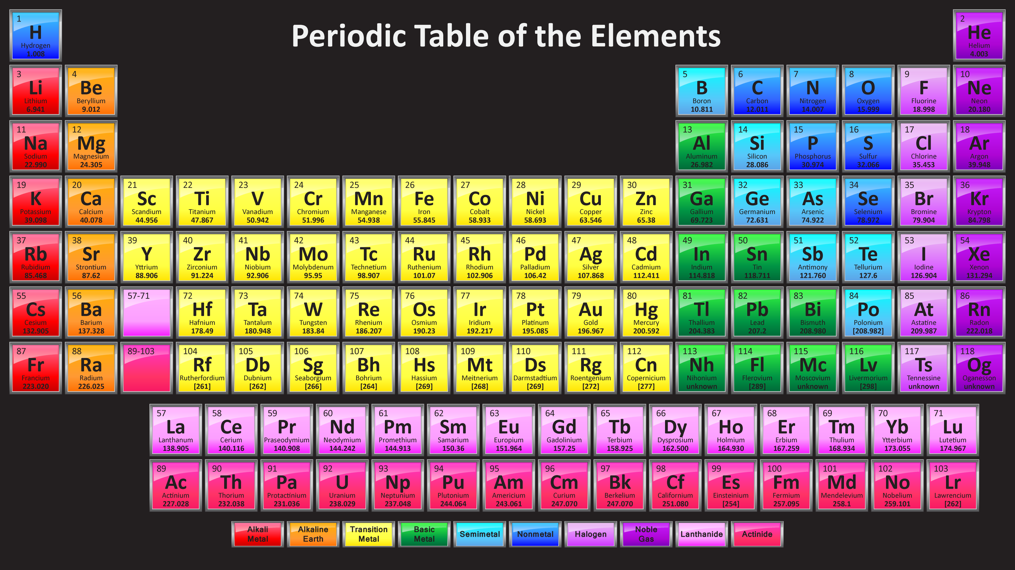

Slide 23
When the body does not receive enough of the minerals it requires, it will take up and use less-preferred minerals to operate its enzyme systems and for other purposes.
This is a basic survival mechanism for all living creatures. However, it is also the cause of a lot of illness.

Slide 24
Dr. Paul Eck learned about this phenomenon from the writing Henry Schroeder, MD (1906-1975). Dr. Schroeder wrote in Trace Elements And Man:
- cadmium avidly replaces zinc and changes or inactivates zinc (dependent) enzymes, causing disease;
- arsenic displaces phosphorus, causing disease;
- - selenium displaces sulfur, causing disease;
- - bromine displaces chlorine (and both bromine and chlorine displace iodine);
- - beryllium displaces magnesium;
- - strontium displaces calcium …”

Slide 25
Dr. Schroeder realized that a chemical element can often be replaced by the element underneath it on the standard periodic table of the elements because they are shaped similarly. All the elements in each column have the same number of electrons in their outer shell, which means they are “shaped” somewhat the same.- For this reason, elements in the same column can “fit” into certain enzymes, like a key that fits into a lock even though it is not the right key to open the lock.
They don’t fit well, but they fit enough to sustain life.

Slide 26
At times, several minerals can substitute for a preferred mineral. For example, zinc is the preferred mineral in over one hundred critical enzymes in our bodies. If it is not present in sufficient quantity, or becomes depleted due to stress, for example, the body can substitute mercury, cadmium, arsenic and possibly others for it. Of course, they do not work as well, but the body can continue to function at a lower level of efficiency.

Slide 27
This is an adaptive mechanism to preserve life.
The purpose of the substitution is to allow life to continue in the face of nutritional deficiencies.

Slide 28
As a rule, the affected enzyme will perform its job far less efficiently with the substitute mineral than it would if the ideal or preferred mineral were present in the enzyme binding site.
Thus mineral substitution is always a bad thing, relatively, and leads to every disease condition imaginable.
When too many preferred minerals have been replaced by substitutes the enzyme efficiency of the body becomes so low that life is not sustainable.

