Slide 1
HTMA – Part 2

Slide 2
There are a few resources to use to learn about HTMA and I encourage you to find each one.
What I am teaching is merely the basics of minerals and patterns, but also, and most important, applying this knowledge through the functional wellness concepts that are taught here in the Mentorship.

Slide 3
Sodium
Sodium is found in all of the body’s cells, as well as in the blood and other bodily fluids.
Sodium (along with potassium) helps to maintain the body’s fluid balance. Sodium plays a huge part in nerve transmission, muscle contraction, and for the creation of hydrochloric acid.
Sodium is the FIRST mineral we waste under stress and the FIRST to tank!

Slide 4
Sodium Deficiencies
allergies
fatigue
anorexia
low blood pressure
apathy
low stomach acid
bloating
poor protein digestion
depression
dizziness
weakness

Slide 5
Potassium
Potassium is needed for the proper functioning of cell, muscle contraction, carbohydrate metabolism, nerve impulses, energy metabolism, and to balance hypertension. Potassium is also closely related with cortisol levels.
We can lose potassium under stress and with detoxing.
We need Vitamin A (from animal sources- think cod liver oil, eggs, butter, and organ meats) to help retain potassium.

Slide 6
Potassium Deficiencies
excessive thirst
irregular heartbeat
insomnia
depression
dry skin
salt retention
anxiety
depression
low cortisol
fatigue
brain fog
constipation
numbness/tingling (limbs constantly falling asleep)
Weak muscles
bloating
allergies
low blood sugar (especially upon awakening)
Sugar cravings

Slide 7
Intracellular vs Extracellular
When we think of sodium and potassium as they relate to the cell, where do each of them live?

Slide 8
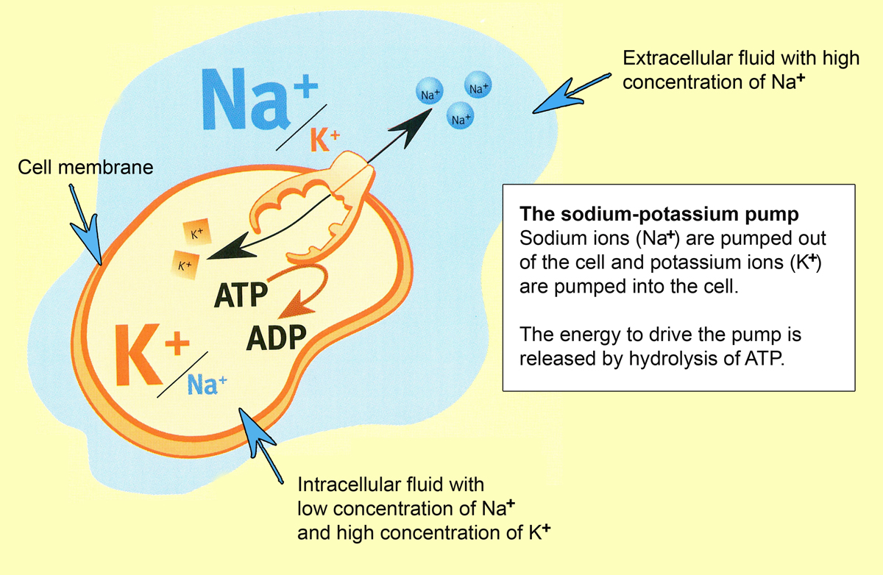

Slide 9
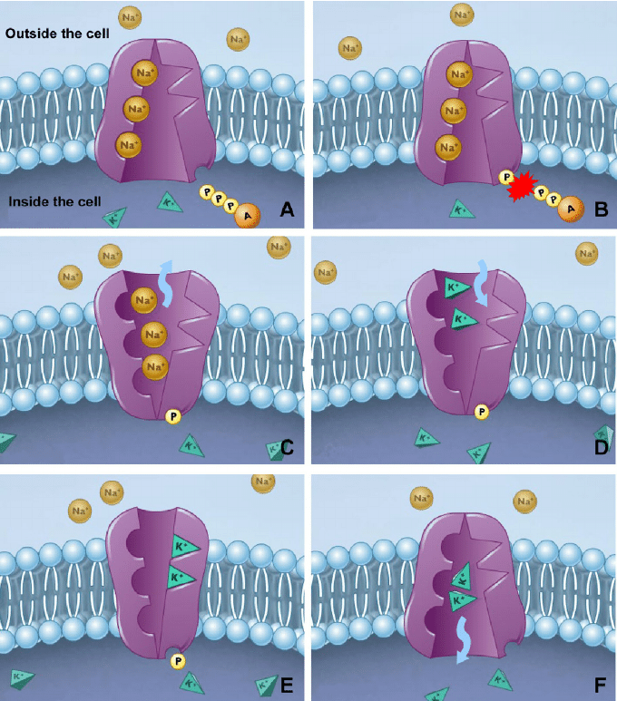

Slide 10
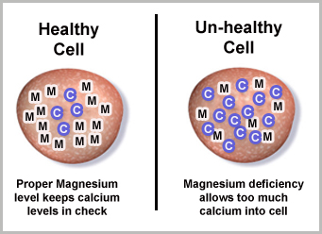

Slide 11
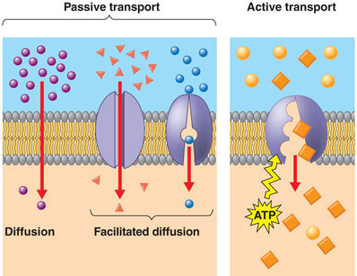

Slide 12
Another interesting aspect of sodium-potassium pumps is that they are involved in kidney function and, in fact, without them it would not be possible.
The kidneys filter 180 liters of plasma every day, which contains substances that must be excreted, while others must be reabsorbed so that they are not lost through the urine.
The reabsorption of sodium, water and other substances depend directly on the sodium-potassium pumps, which are found in the tubular segments of the kidney nephrons.

Slide 13
Blood testing can be a real compliment to HTMA.
On a blood test, what can we gather from low sodium and optimal potassium? What about low potassium and optimal sodium?

Slide 14
This demonstrates the stress response.
Let’s take a look at what the cell is doing when this is happening.

Slide 15
A hyper-adrenal stress response will:
Raise aldosterone causing the kidney to re-absorb sodium.
Excess sodium will be pulled into the cell.
Potassium and magnesium will be pushed out.

Slide 16
HTMA:
Can measure minerals both retained in or excreted from cellular storage.
Calcium and Sodium – extracellular
Magnesium and Potassium - intracellular

Slide 17
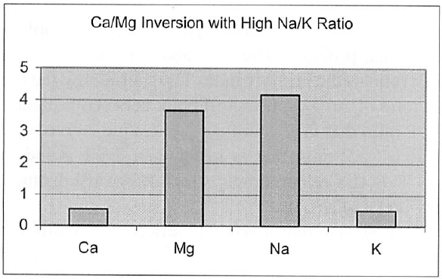
Notes:
What does this image say to you?
Hyperadrenal picture, a lot of severe stress forcing sodium into the cells and tissues because it is being retained. We know it is in tissues because we see it here in a high amount…we know it is in the cells because sodium does not belong in the cells and has pushed potassium out of the cell, the body is excreting it in urine. Magnesium is being forced out of the cell, or lost and being excreted into the hair tissue.
The body tends to retain calcium in a magnesium depletion and we are likely to find it in the cell where magnesium used to be.
What symptoms would we expect to see in this case?

Slide 18
Just like blood work, HTMAs can have patterns that “hide” the real picture.

Slide 19
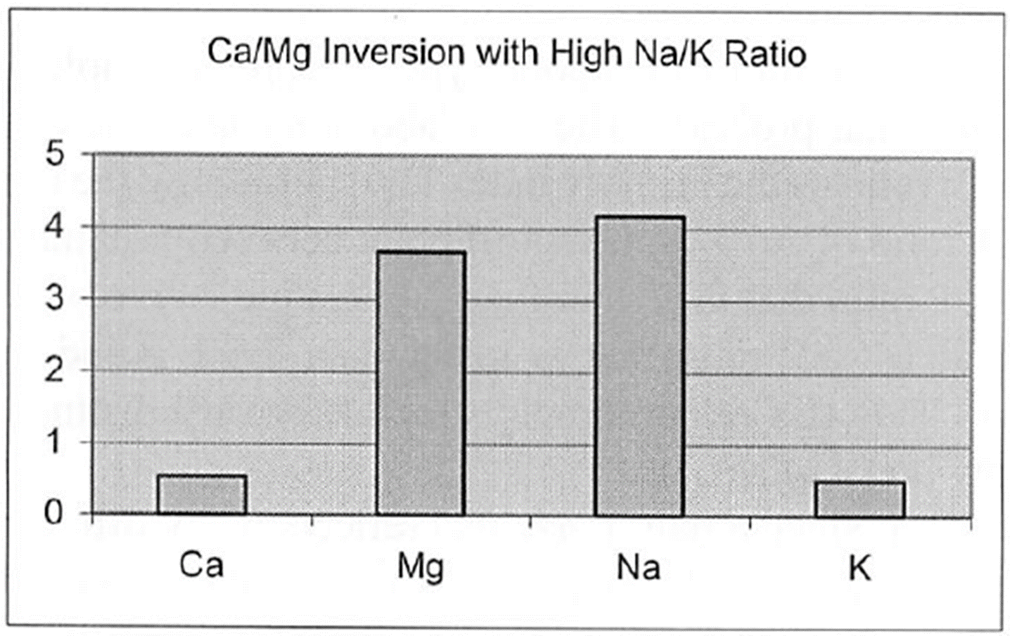
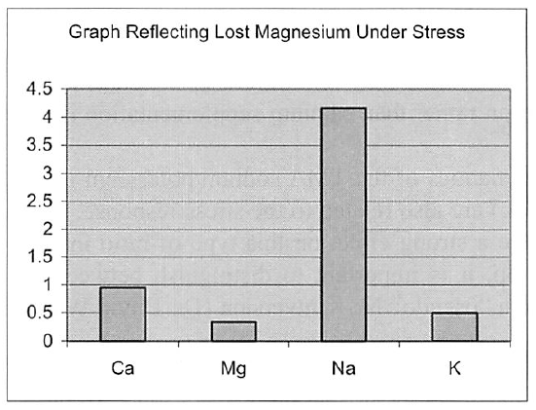
Notes:
What does this image say to you?
Hyperadrenal picture, a lot of severe stress forcing sodium into the cells and tissues because it is being retained. We know it is in tissues because we see it here in a high amount…we know it is in the cells because sodium does not belong in the cells and has pushed potassium out of the cell, the body is excreting it in urine. Magnesium is being forced out of the cell, or lost and being excreted into the hair tissue.
What symptoms would we expect to see in this case?

Slide 20
Healing happens in stages.
There is a huge difference between treating an illness
and healing your body.

Slide 21
HTMA Calcium and Magnesium
When we have magnesium deficiency, the body is more likely to retain calcium. This is similar to the relationship of sodium and potassium.
Too much calcium blocks magnesium and creates deficiency (why is my client not absorbing this magnesium?)

Slide 22
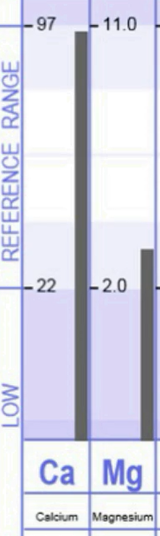
So, excess Ca and low Mg could:
Create glucose dysregulation and raise insulin
(where can we correlate on a blood test?)
Increase all types of cravings
Increase muscle spasms and aches
(what role would Ca play in that?)

