Slide 1
PPE (Postprandial Endotoxemia)

Slide 2
What are endotoxins?
From where do they originate?
How are they harmful?
What is the difference between PPE and Metabolic Endotoxemia?

Slide 3
What are endotoxins?

Slide 4
Both gram-negative and gram-positive bacteria have a plasma membrane and a peptidoglycan layer in their cell wall.
However, gram-negative bacteria have characteristics that separate them from gram-positive bacteria.
The peptidoglycan layer of gram-negative bacteria is much thinner than that of gram-positive bacteria but they have an outer membrane covering it.

Slide 5
This outer membrane contains a fatty sugar layer called lipopolysaccharide (LPS).
The term lipopolysaccharide can be broken into two words: lipo (fat) and polysaccharide (sugar). Within the lipid portion of this LPS layer is lipid A, which is a dangerous endotoxin.

Slide 6
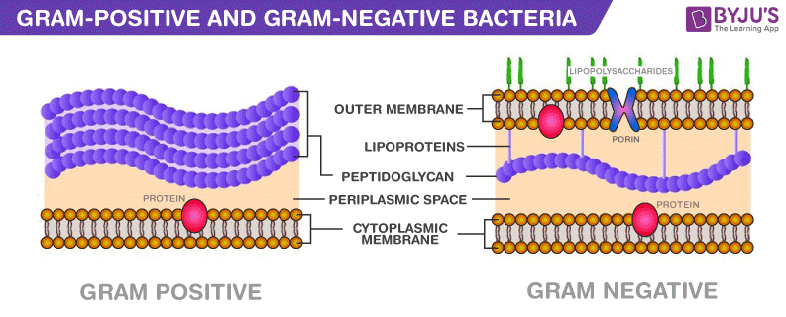

Slide 7
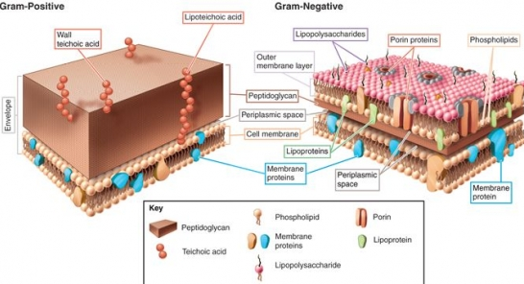

Slide 8
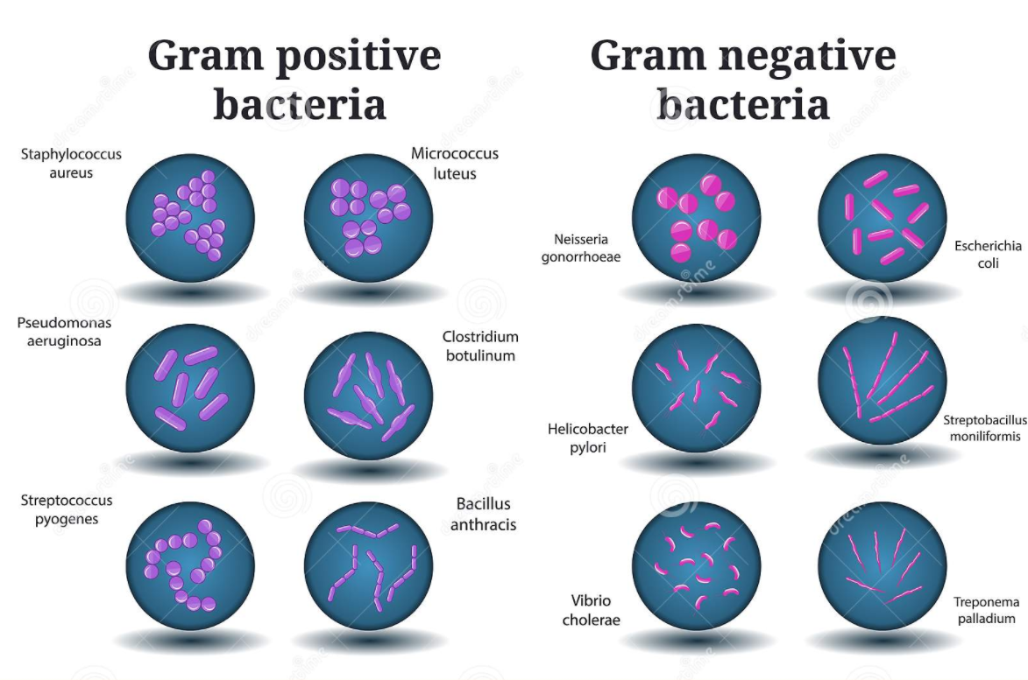

Slide 9
From where do they originate?

Slide 10
When gram-negative bacteria are destroyed, either by antibiotics or by our immune system, they release toxins into our body called endotoxins.

Slide 11
Endotoxins are also brought in with food.

Slide 12
How are they harmful?

Slide 13
Endotoxins stimulate the release of large amounts of proteins called cytokines. Cells communicate with each other via cytokines, and these particular cytokines stimulate the activation of the immune system. They send messages to the cells in our immune system to clear the endotoxins. However, the large number of cytokines released can overwhelm the body, and become toxic in and of themselves. This in turn releases a cascade of inflammatory events, leading to symptoms that include fever, aches, shock, and even death.

Slide 14
What is Postprandial Endotoxemia?

Slide 15
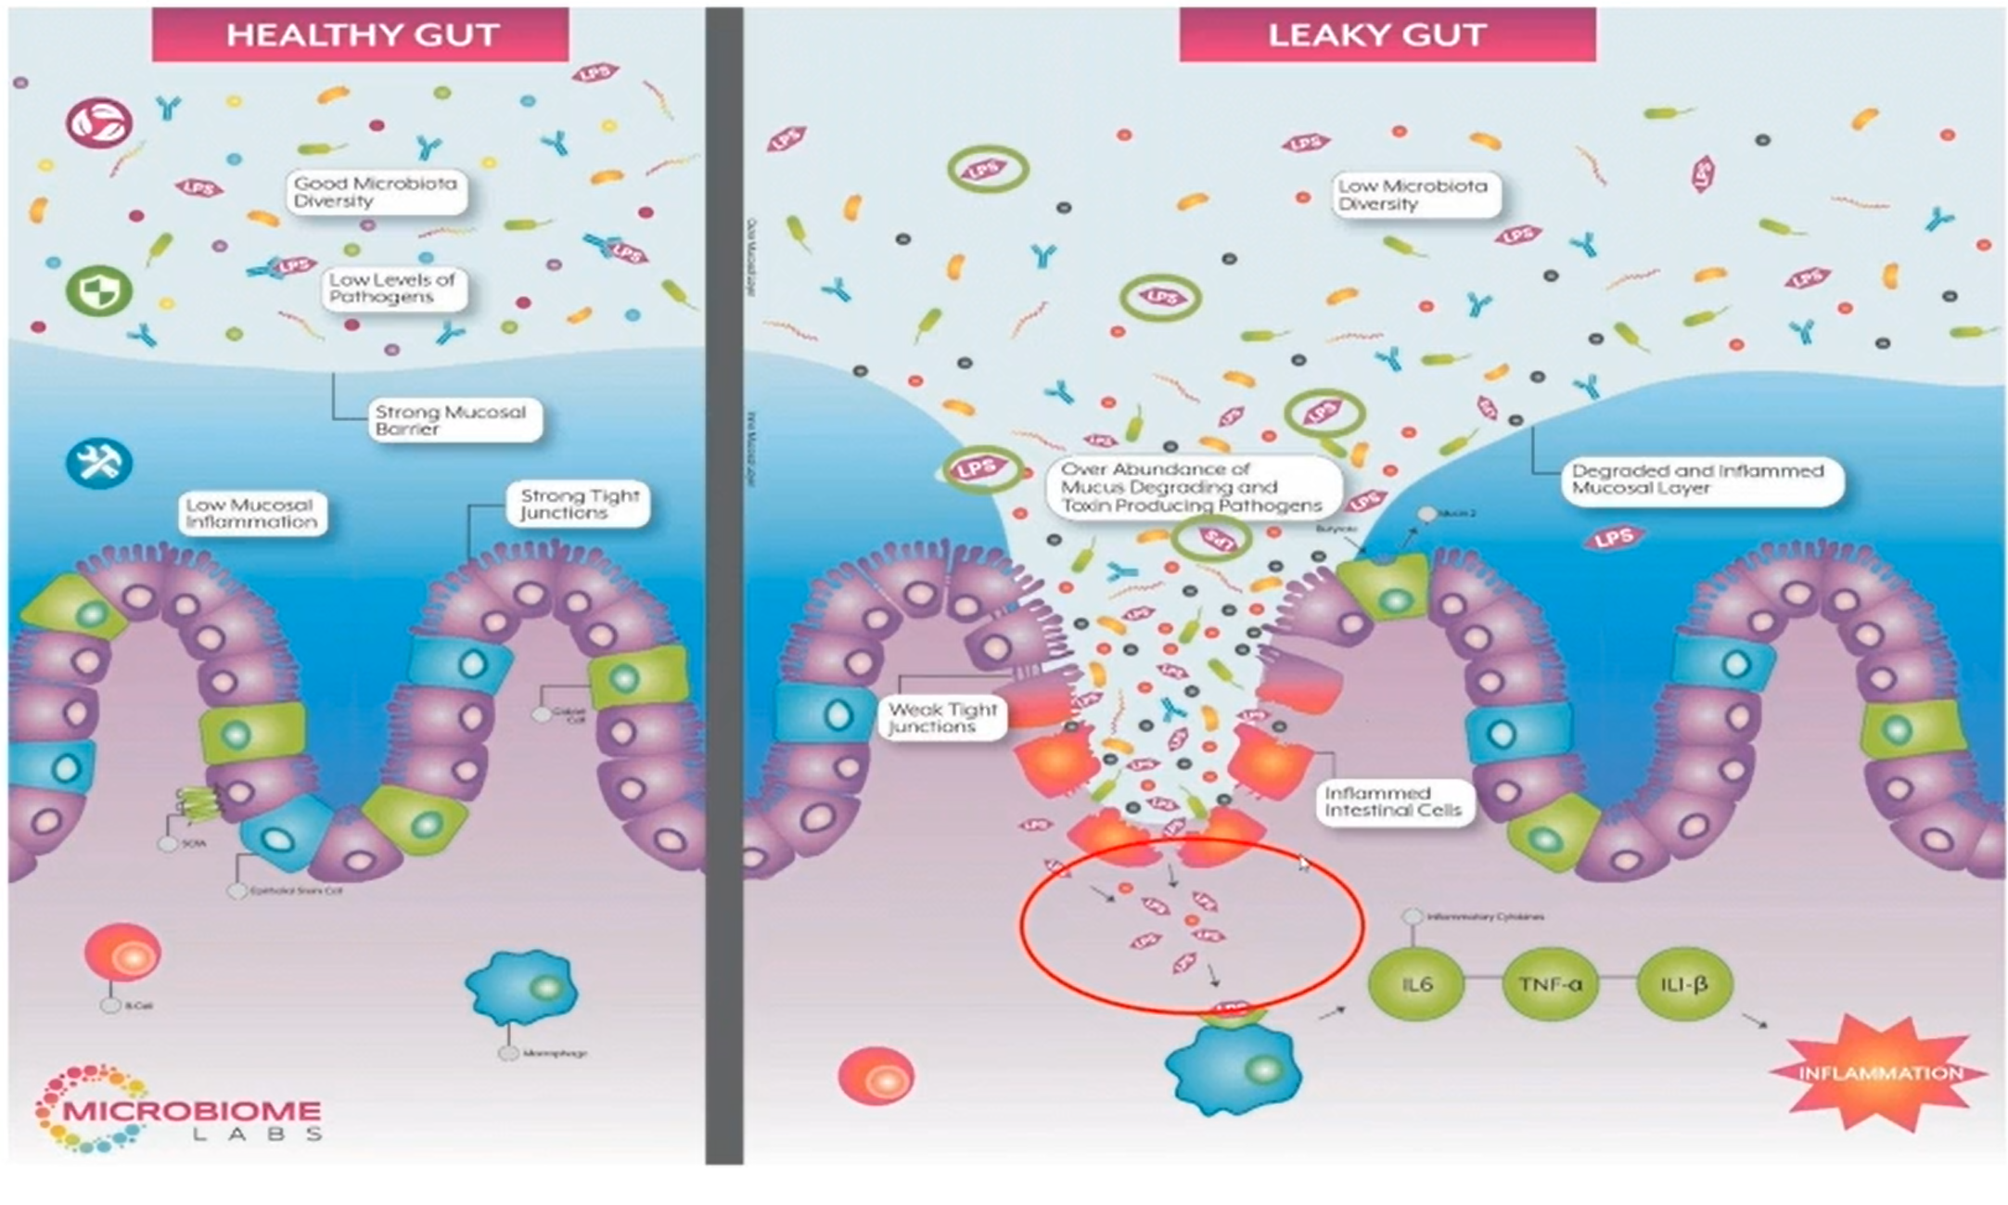
Notes:
Plenty of good bacteria are gram negative. As we saw, LPS is located in the coating of the gram neg bacteria as a trans membrane compound. LPS in the membrane is not an issue until the cell dies and LPS is released into a gut with poor barrier conditions.
What is a leaky gut? Let’s clarify this first. The act of eating will itself make the gut more permeable for three to four hours after eating to allow final digestion in the small intestine and final absorption of nutrients and minerals. The gut then becomes more IMpermeable until the next meal.
These damaged areas (see image) start small with mucosal breakdown, which leads to irritation and inflammation, spreading the tight junctions and destruction of epithelial cells. LPS then enters into the blood stream causing increased local and systemic inflammation.
This is not the entire lining of the small intestines, just small areas and these can grow into separate areas of concern. This is the part we are healing when we talk about gut healing, NOT the permeability that occurs after eating and that lasts 3 to 4 hours.
Why is PPE worse during eating? During eating, bacteria die due to acidic chyme bolus dropping into the small intestine, the release of bile which is a strong anti-microbial and then bile triggers the FXR nuclear receptor which encourages the endothelium cells to release their own antimicrobials, and along with churning and peristalsis, creates die off effect, so gram negative bacteria die and release LPS. Now what about higher fats being an issue?

Slide 16
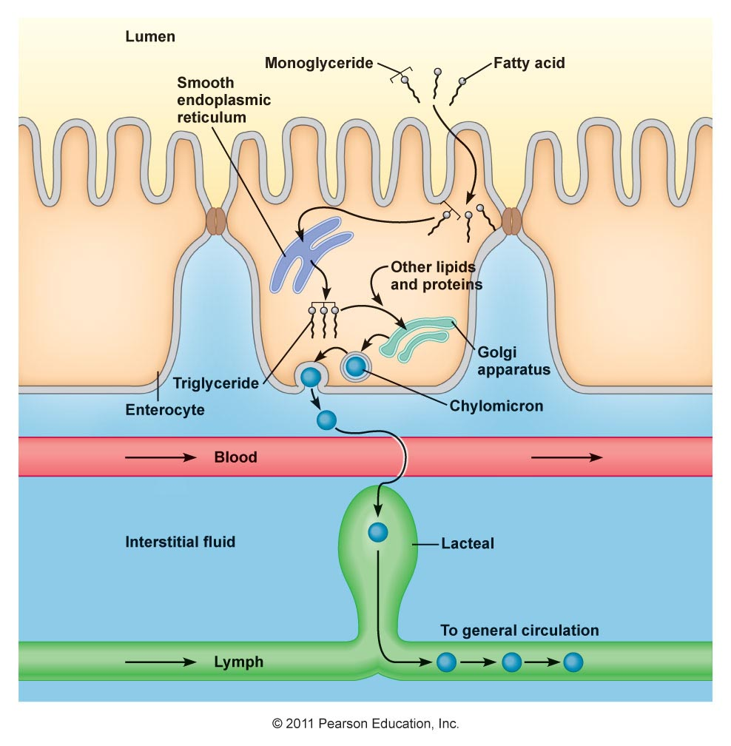
Notes:
LPS is a fatty acid compound. Lipid rafts, aka chylomicrons, will help cross over, pick up fatty acids and them bring them back into the circulatory system. In that process, LPS in inadvertently picked up.
Main reason higher fat increases this grab of LPS is because a higher fat meal will increase the chylomicrons.
Have always heard coconut oil was the worst and now I understand why and that is due to its high antimicrobial properties.
Food stuff itself can deliver the majority of gram neg bacteria, which is then killed off. This is how we get so much of it present in the small intestine. Heavy cream has a huge amount!

Slide 17
What is Metabolic Endotoxemia?

Slide 18
Metabolic Endotoxemia is enacted once the LPS has entered into the blood stream. It then starts a potent inflammatory cascade, similar to sepsis. Every time we eat, it’s like a mini-sepsis.
So what are the clear, clinical manifestations?

Slide 19
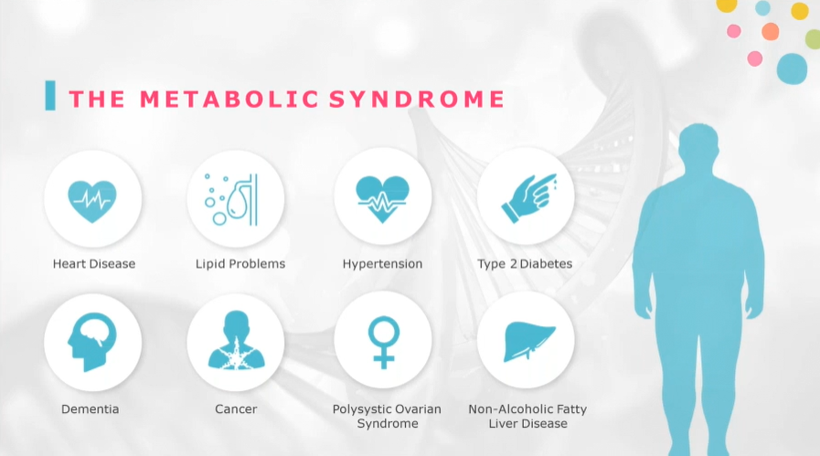
Notes:
Everything under the Metabolic Syndrome spectrum has been shown to be driven by Metabolic Endotoxemia. They all have very similar etiologies that start the same way.

Slide 20
What is the difference in diets containing fat?
Is ALP low due to LPS amounts?
TUDCA and LPS
Where does LPS go?

