Slide 1
HTMA – Part 4

Slide 2
There are a few resources to use to learn about HTMA and I encourage you to find each one.
What I am teaching is merely the basics of minerals and patterns, but also, and most important, applying this knowledge through the functional wellness concepts that are taught here in the Mentorship.

Slide 3
Easy Resources to Support Learning
https://traceelements.com/EducationalResources/PublishedArticles.aspx
https://traceelements.com/EducationalResources/NewsLetter.aspx
https://arltma.com/newsletters/

Slide 4
The Ratios
What is considered the most important ratio?

Slide 5
The sodium/potassium ratio.
We know that the hair sodium level is a marker for how aldosterone (a mineralocorticoid hormone) is working in your body.
The hair potassium level is a marker for how the glucocorticoid hormones are working – specifically cortisol.
So when we look at the sodium/potassium ratio what we’re really looking at is the balance of the mineralocorticoid hormones (aldosterone) to the glucocorticoid hormones (cortisol).
For instance, if your sodium/potassium ratio is high it means you have more aldosterone relative to cortisol. Aldosterone is more of an acute inflammatory hormone so we can deduce that this is associated with acute inflammation in the body and even certain emotions like anger.
Notes:
How does this relate to a blood sodium and potassium?
Will the levels relate to each other?

Slide 6
Sodium/Potassium - Vitality, Adrenals, and Life/Death Ratio or “Our Stress Response”
  The sodium/potassium ratio is considered the most important ratio on the test. If there are numerous imbalances on the mineral analysis, it is best to focus on correcting this one first. These minerals help us understand the adrenals and kidneys and are affected by stress, inflammation and an anti-inflammatory response as well.
  This is the single most important ratio to assess the immune system. When it is low it is called an inversion. The low ratio indicates immune system weakness. It also indi­cates chronic adrenal weakness, fatigue and tissue catabolism. A loss of potassium from damaged cells causes the higher potassium reading in relation to sodium.
  The Na/K shows us our overall vitality, adrenal health, liver and kidney function, digestion, and how our body is reacting to stress.

Slide 7
A high Na/k ratio shows a possibility of:
inflammation
- adrenal imbalance (usually an acute stress situation, and the beginning stages of adrenal fatigue)
- asthma
- allergies
- More common with fast oxidizers
- kidney and liver stress
- A high sodium/potassium ratio is considered preferable to a low sodium/potassium ratio.

Slide 8
A low Na/K ratio shows a possibility of:
kidney and liver dysfunction
- allergies
- arthritis
- tissue breakdown
- low immune system
- adrenal exhaustion/burnout (usually because of chronic stress)
- digestive problems (especially deficiency of hydrochloric acid)
- Very common in slow oxidizers
- Low na/k ratios that are hard to budge can be due to a history of trauma. Child abuse victims tend to have very low na/k ratios

Slide 9
The Ratios
What is considered the most important ratio?
Sodium/Potassium - Vitality, Adrenals, and Life/Death Ratio or “Our Stress Response”
  The sodium/potassium ratio is considered the most important ratio on the test. If there are numerous imbalances on the mineral analysis, it is best to focus on correcting this one first. These minerals help us understand the adrenals and kidneys and are affected by stress, inflammation and an anti-inflammatory response as well.
  This is the single most important ratio to assess the immune system. When it is low it is called an inversion. The low ratio indicates immune system weakness. It also indi­cates chronic adrenal weakness, fatigue and tissue catabolism. A loss of potassium from damaged cells causes the higher potassium reading in relation to sodium.

Slide 10
The Ratios
What is considered the most important ratio?
Sodium/Potassium - Vitality, Adrenals, and Life/Death Ratio or “Our Stress Response”
  The sodium/potassium ratio is considered the most important ratio on the test. If there are numerous imbalances on the mineral analysis, it is best to focus on correcting this one first. These minerals help us understand the adrenals and kidneys and are affected by stress, inflammation and an anti-inflammatory response as well.
  This is the single most important ratio to assess the immune system. When it is low it is called an inversion. The low ratio indicates immune system weakness. It also indi­cates chronic adrenal weakness, fatigue and tissue catabolism. A loss of potassium from damaged cells causes the higher potassium reading in relation to sodium.

Slide 11
Sodium/Potassium - Vitality, Adrenals, and Life/Death Ratio or “Our Stress Response”
  When the ratio is high, signals a “fight or flight” response
  Internal vs external stressors
    what are the differences as we have discussed in functional wellness?
Notes:
Fight or flight can be expressed as fear, anxiety, anger and is extreme and determines a dominant emotional expression, i.e. melancholy or quick to anger, very little joy, negative
Internal vs external – physiological stressors are also seen by the body and it is aware it is experiencing stress

Slide 12
The Ratios
What is considered the most important ratio?
Sodium/Potassium - Vitality, Adrenals, and Life/Death Ratio or “Our Stress Response”
  The sodium/potassium ratio is considered the most important ratio on the test. If there are numerous imbalances on the mineral analysis, it is best to focus on correcting this one first. These minerals help us understand the adrenals and kidneys and are affected by stress, inflammation and an anti-inflammatory response as well.
  This is the single most important ratio to assess the immune system. The low ratio indicates immune system weakness. It also indi­cates chronic adrenal weakness, fatigue and tissue catabolism. A loss of potassium from damaged cells causes the higher potassium reading in relation to sodium.
Notes:
Aldosterone is more of an acute inflammatory hormone so we can deduce that this is associated with acute inflammation in the body

Slide 13
The Ratios
What is considered the most important ratio?
Sodium/Potassium - Vitality, Adrenals, and Life/Death Ratio or “Our Stress Response”
  The sodium/potassium ratio is considered the most important ratio on the test. If there are numerous imbalances on the mineral analysis, it is best to focus on correcting this one first. These minerals help us understand the adrenals and kidneys and are affected by stress, inflammation and an anti-inflammatory response as well.
  This is the single most important ratio to assess the immune system. The low ratio indicates immune system weakness. It also indi­cates chronic adrenal weakness, fatigue and tissue catabolism. A loss of potassium from damaged cells causes the higher potassium reading in relation to sodium.
Notes:
Aldosterone is more of an acute inflammatory hormone so we can deduce that this is associated with acute inflammation in the body

Slide 14
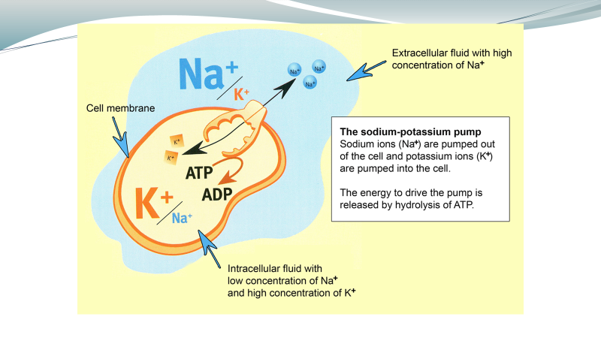
Notes:
Aldosterone is more of an acute inflammatory hormone so we can deduce that this is associated with acute inflammation in the body

Slide 15
Iodine Deficiency

Slide 16
Iodine Deficiency
Iodine is not stored in hair and can only be properly measured via a loading 24-hour urine test.
We might consider:
  Calcium >50 (iodine de-calcifies)
  Potassium <4
  Copper >2.5 (may also be low)
  Selenium <.08
  Lithium<.004
  Mercury >.02
  Ca/K ratio >10.1

Slide 17

Iodine Deficiency
Using T3 and rT3 to determine levels?
Notes:
There are 2 courses out there that teach this but I would say that iodine determination can ONLY be determined by elevations over 15 when using T3. Less than 9 calls into fact that T3 is low and then other factors become involved such as liver health.
Mathematically, you would need to have a good level of T3 and lowish rT3 to be able to determine this ratio and many people do not have these levels in a functional range.
You could also use the levels illustrated of fT3 and fT4 with rT3 as a pattern of iodine need.

