Slide 1
Easy Tea Infusions Guide to Brewing
6.16.23

Slide 2
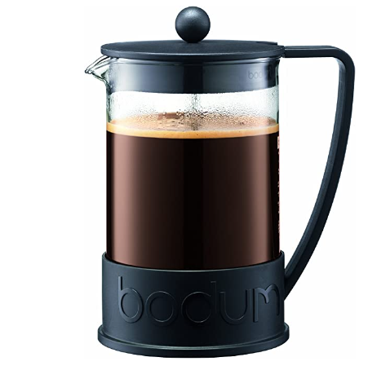
Bodum Brazil French Press Coffee Maker, 1.5 Liter, 51 Ounce

Slide 3
Set water to boil.
Add 1 ½ Cups of loose teas to press.
Once water boils, pour over tea and stir.
Fill to just under the pour spout.
Place the lid on and push down just below the water line.
Allow the tea to cool.
Push the press down completely and place in the refrigerator.

